Slide 1

Collage:-Abacus Institute Of Engineering And Management
CARE AND CURE
[Online Medicine Shop]
Name:-Tanaya Das
Notes:
;

Slide 2
Introduction
The project Medicine Ordering System is surely going to make ordering of medicine a lot easier. Customer can very easily order medicine through the web portal. User can now order medicine from the comforts of their home.

Slide 3
Why we have choose the
Project Topic
To provide online ordering facilities.
Support service in an integrated fashion so as to provide a simple and hassle free ordering platform.
Advantage
Disadvantage

Slide 4
Requirements for this project
Software Requirements
Front End : HTML, CSS, JS, BOOTSTRAP
Middle End : Apache
Application Server : XAMPP
Database Server : My SQL

Slide 5

Project up to
Index Page/Home Page

Slide 6
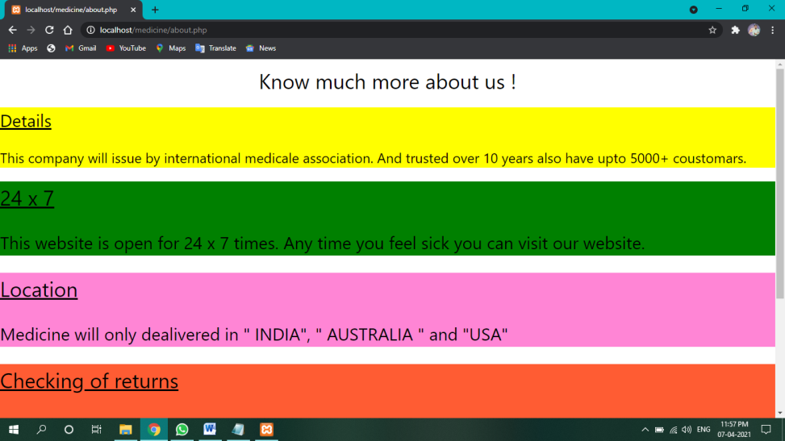
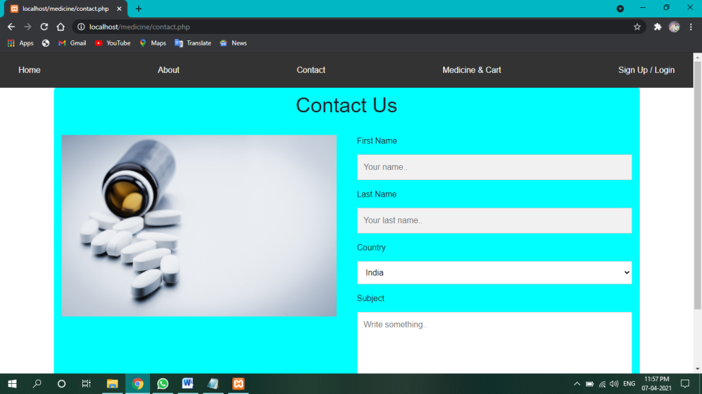
About Page Contact Page

Slide 7
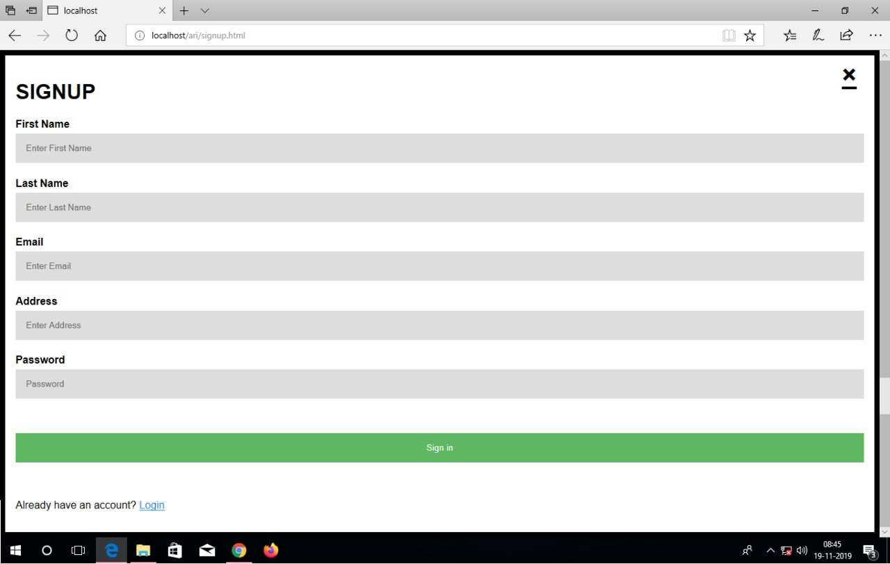
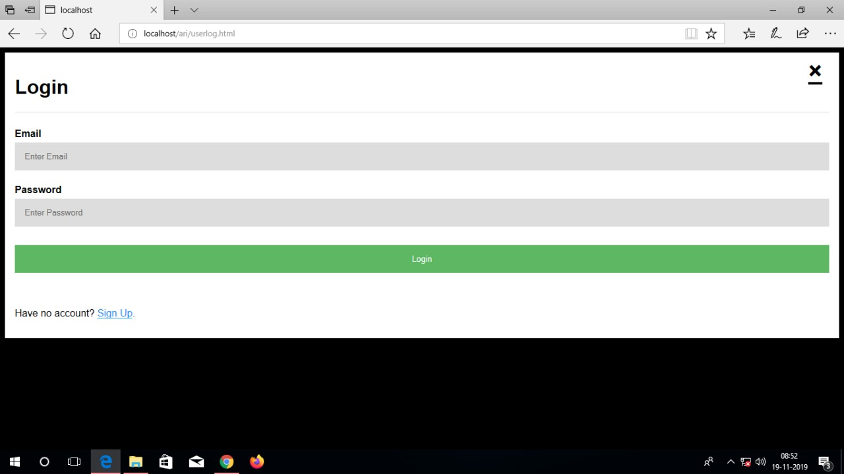
Signup Page Login Page

Slide 8
Conclusion
Farther scope and further enhancement of the Project

Slide 9


